Slide 1
Week 47
Steering meeting
Group 1

Slide 2
Week 47 time tracking in hours
Team member | Week 47 | Total time
André | 20 | 48
Anton | 17 | 58
Amer | 26 | 64
Džana | 16 | 58
Jawid | 20 | 58
Kevin O. | 23 | 54
Robert | 20:13 | 57:34
Noah | 22 | 50

Slide 3
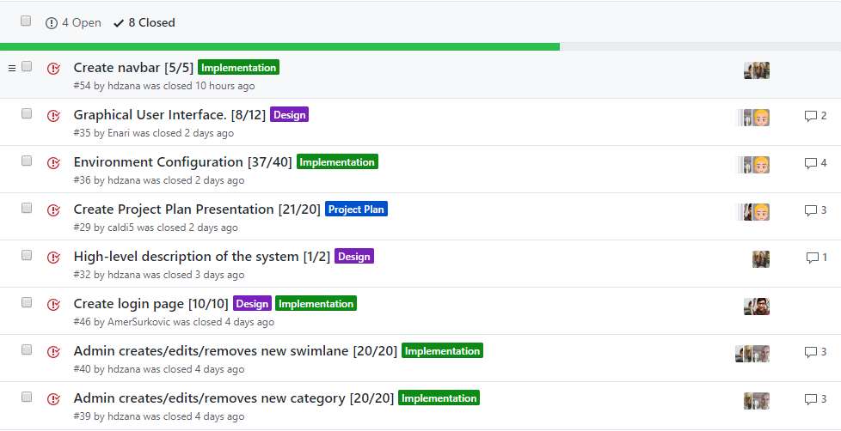
Previous Week

Slide 4
Previous Week

Slide 5
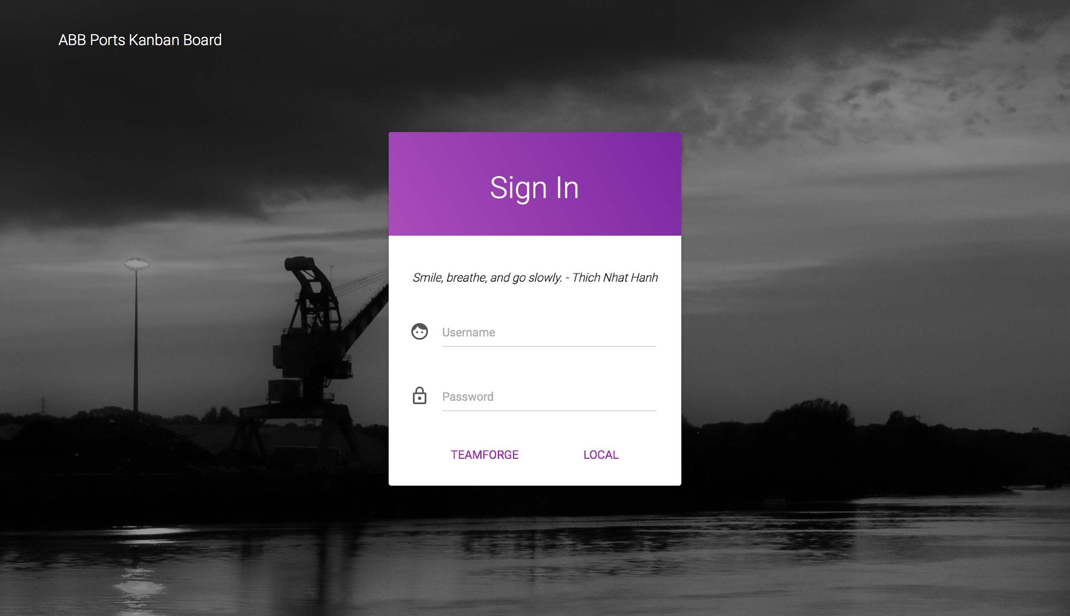

Slide 6

Obstacle and Issues
Still...

Slide 7
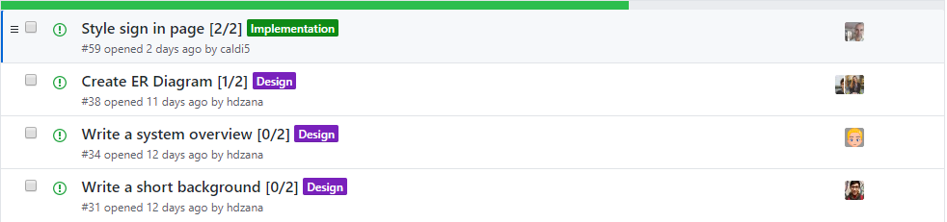
This Week

Slide 8
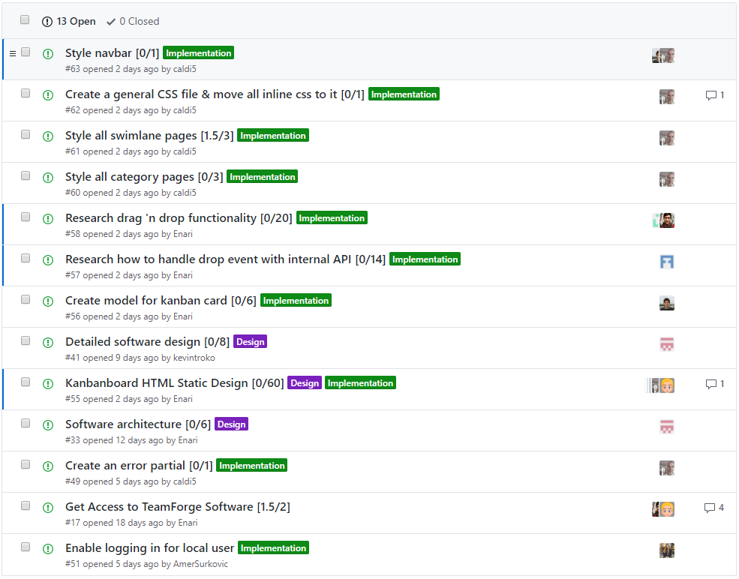
This Week

Slide 9
This Week

